Slide 1
Present Continuous Tense - это такая форма Настоящего времени, которая показывает, что действие совершается в момент речи, то есть прямо сейчас.

Slide 2
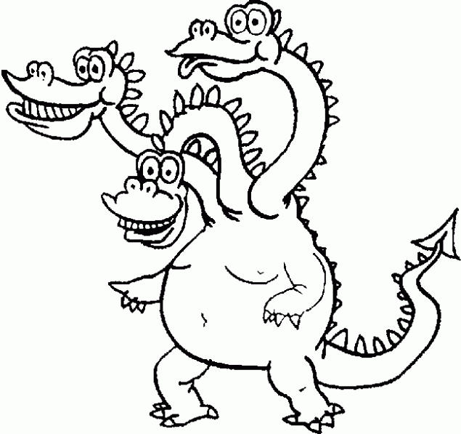
Время Present Continuous – это дракон.
А у дракона 3 головы – это am, is, are
Его тело – это глагол play ,
а хвост – ing.
am
is
are
play
ing

Slide 3
I | am = ’m | playing
He She It | is = ’s | danceing
You We They | are = ’re | running

Slide 4
Put in am, is or are
1. I … watching TV.
2. Lulu … flying a kite.
3. The child … making a sandcastle.
4. The children … playing a game.

Slide 5
Put in am, is or are
5. Lulu and Maya … driving a car.
6. You … painting a picture.
7. Your dad … playing soccer.
8. My mum and I … sleeping.

Slide 6
Make up statement, negative and question. Составь утвердительное, вопросительное и отрицательное предложение.
I ______ (fly) a kite now.
We _____(sit) at the desk now.
She ___(drink) orange juice now.

Slide 7
Find out mistakes Найди ошибки
- I am swiming.
-They are makeing a cake.
-We are go to the cinema.
- My brother is listenning to the radio.
- My friend is runing to school.
- We is watching TV.

Slide 8
WELL DONE !!!

